Slide 1
Buying and oversight
How do I question a vendor and decide build, buy or partner?
Applied AI and Automation | Session 10 of 12
KLAi Professional Learning | Jotham Martin Wambi
Notes:
Welcome to Session 10. Start with your question from last time: which AI product has someone pitched to you, and what would you need to know before saying yes?
You can now build small automations yourself, so you are in a good position to judge what vendors offer. Today you learn how to mark a proposal line by line, read a sample proposal with a sharp eye, and decide whether your own task should be built, bought or done with a partner.

Slide 2



Today in one view: what you will leave with
By the end of today you will have
A scored review of a sample vendor proposal, using the Vendor Question List
Five questions for your own vendor, each with the answer that would be a red flag
A build, buy or partner decision for your own task, with the reason
Notes:
Here is what you leave with. A scored review of a sample vendor proposal. Five questions for your own vendor, each with the answer that would worry you. And a decision on build, buy or partner for your own task. You do not need technical knowledge for any of it.
You need the right questions and the habit of asking for evidence.

Slide 3
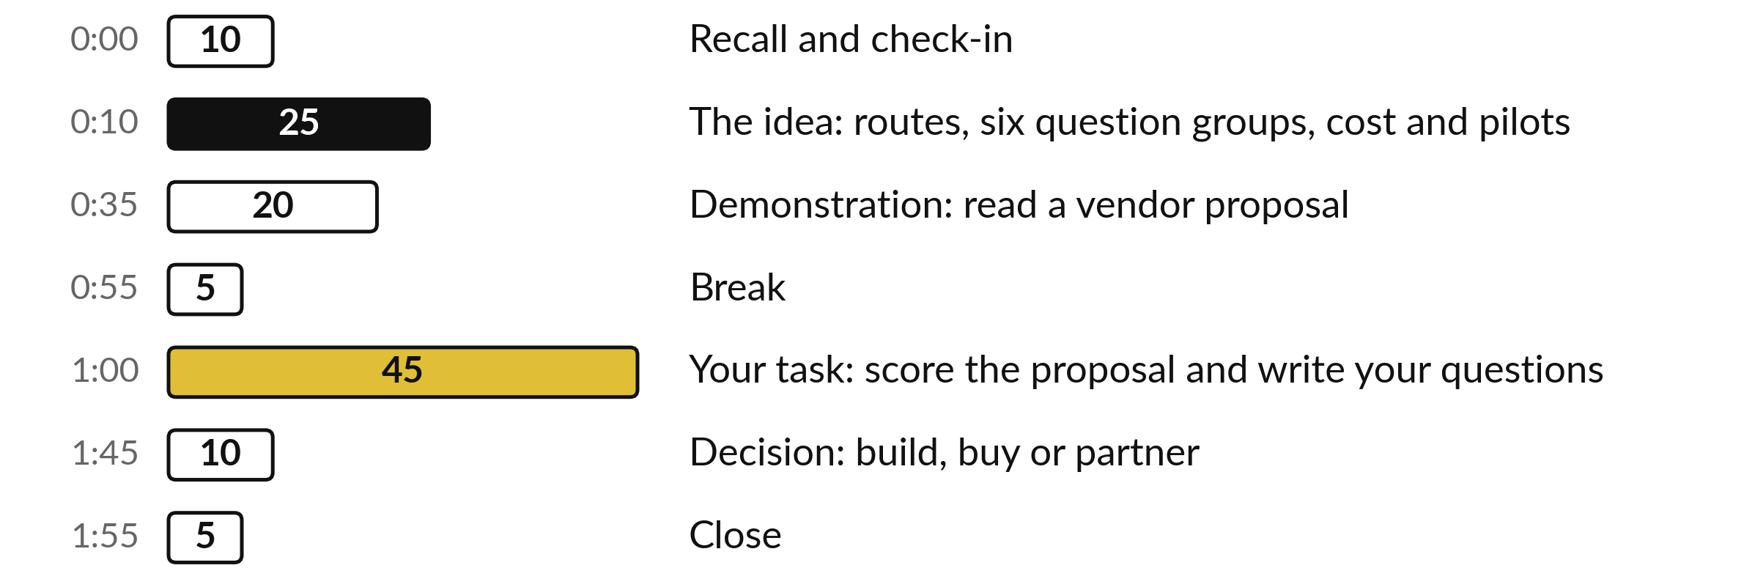
Your two hours: 45 minutes are your own work
45 of the 120 minutes are yours: score a proposal, then write questions for your own vendor.
Notes:
Three parts take most of the time. Twenty-five minutes on the idea: the three routes, six groups of questions, cost and pilots. Twenty minutes on a live reading of a fictional proposal. After the break, forty-five minutes are yours: score the proposal, then write your own five questions.
The last ten minutes are for your decision on build, buy or partner.

Slide 4

Three questions from last time
1. How do you score a risk, and which scores are High, Medium and Low?
2. Which law covers personal data used with AI tools in Uganda?
3. What are the steps when something goes wrong?
Answer aloud first. Then we check together.
Notes:
Three quick questions from Session 9. Answer aloud first, and then we check together. It is a warm-up to bring last time back.
Question one. How do you score a risk, and which scores are High, Medium and Low? Take a moment.
A good answer is this. Likelihood times impact, each from 1 to 5. High is 15 or more, Medium is 8 to 14, Low is below 8.
Question two. Which law covers personal data used with AI tools in Uganda? Say it to yourself first.
A good answer is this. The Data Protection and Privacy Act 2019. There is no AI statute. Confirm your duties with a lawyer or the Personal Data Protection Office.
Question three. What are the steps when something goes wrong? Think about your own task as you answer.
A good answer is this. Stop or switch off, tell the owner, do it by hand, record what happened, decide who must be told. Then fix the cause and update the policy.
If an answer was missing, your own task card or last workbook page has it. Now to today.

Slide 5





Words we use today
Word | What it means
Build, buy, partner | Make it yourself, licence a product, or pay a firm to build and support it.
Agent washing | Calling ordinary software an AI agent without evidence that it can act on its own.
Total cost of ownership | Everything the tool costs over its life: licences, set-up, training, review time, support and switching.
Pilot | A small, time-limited trial with a baseline, a success measure and a stop rule.
Exit clause | The contract words that say how you leave, get your data back and have it deleted.
Notes:
Five words for today. I give the plain meaning of each, and we use every one of them before the end of the session.
Build, buy, partner. Make it yourself, licence a product, or pay a firm to build and support it.
Agent washing. Calling ordinary software an AI agent without evidence that it can act on its own.
Total cost of ownership. Everything the tool costs over its life: licences, set-up, training, review time, support and switching.
Pilot. A small, time-limited trial with a baseline, a success measure and a stop rule.
Exit clause. The contract words that say how you leave, get your data back and have it deleted.

Slide 6
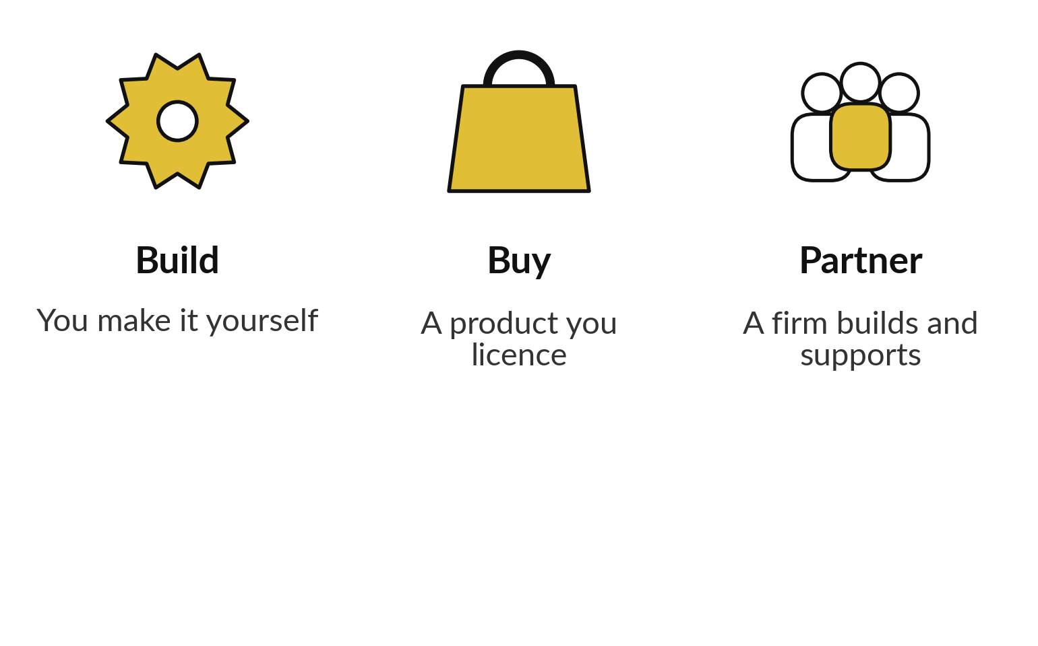
You can build it, buy it or partner to get it built
Choose the route for your own task, using what you now know.
Build when the task is yours alone and the logic is simple.
Buy when many companies share the task.
Partner when you lack set-up and support.
Notes:
Three routes. Build means you make it yourself with the tools you used in Sessions 6 and 8. Buy means you licence a product that many companies use. Partner means a firm builds and supports it for you. Build suits a task that is yours alone and has simple logic, as your measured script showed.
Buy suits a task that many companies share. Partner suits you when you need set-up and support that you lack. Each route needs oversight, and you stay responsible for the result whichever you choose. Say now which route you would guess for your own task. You can change your mind later.

Slide 7
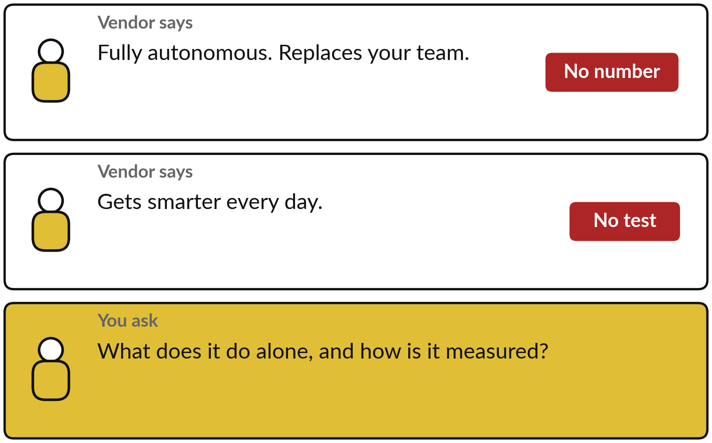
Agent washing is calling
ordinary software an agent
A label is not evidence.
Ask what it can do alone.
Ask how that is measured.
Ask what a person must still approve.
Notes:
In Session 7 you drew the boundary for an automation. Some vendors skip that and use big labels. Agent washing means calling ordinary software an agent, or an automation fully autonomous, with no evidence. Look at the two claims on the card. Neither holds a number or a test.
Your reply sits in the gold box: ask what the tool can do alone, what a person must still approve, and how the vendor measured that. Treat an answer with no number as no answer yet, and ask again in writing.

Slide 8
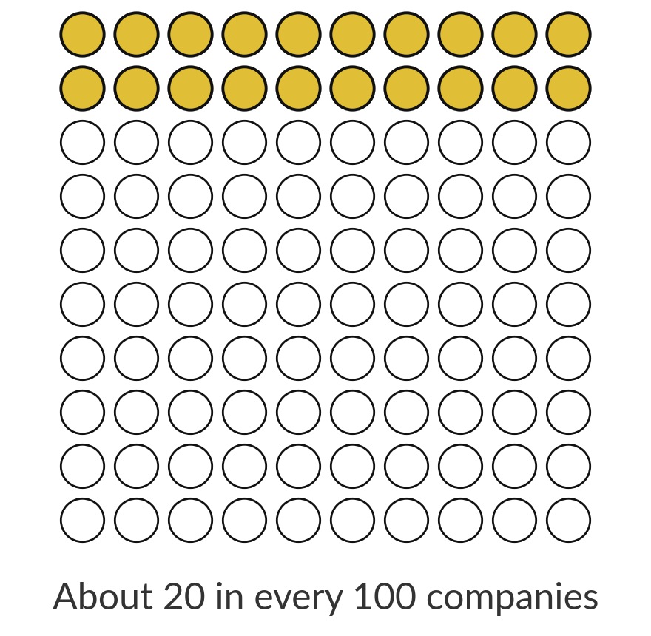
Few companies have mature
oversight for AI agents yet
1 in 5
companies have a mature governance model for AI agents. This is a large-firm, global figure.
Source: Deloitte, 2026 survey (large firms, global)
Notes:
A fact about oversight. In a 2026 Deloitte survey, only about one company in five had a mature governance model for AI agents. That is the gold group of dots. These are large global firms, so the figure may differ for yours. A clear owner and a stop rule already put you ahead of that picture, and you already know how to write both.
Ask each vendor how they would show you the same things, a baseline, a stop rule and a named owner, before you sign.

Slide 9






Six groups of questions to ask any AI vendor
1 Data and privacy: training on our data, where it is kept.
2 Security: which standard, and the report.
3 Accuracy evidence on our kind of data.
4 Pricing drivers: per user, task or usage.
5 Contract and exit: length, renewal, leaving.
6 Support and references we can call.
Notes:
Six groups of questions, and they match the Vendor Question List you will use today. Data and privacy: can we turn off training on our data, and where is it kept and deleted?
Security: which standard do they hold, and can we see the report?
Accuracy evidence: what shows it works on our kind of data?
Pricing drivers: per user, per task or by usage?
Contract and exit: how long, how it renews and how we leave. Support and references: who helps, and who can we call?
The list has thirty questions, five in each group. You will not ask them all. Later today you pick the five that matter most for your task.

Slide 10
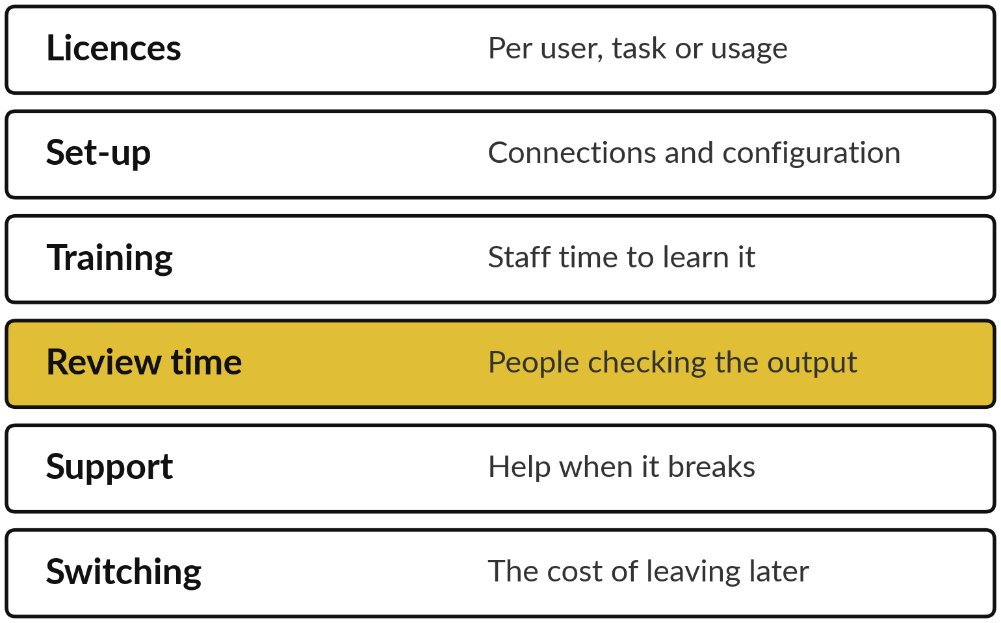
The price is one part of what an AI tool costs you
Total cost of ownership is the sum of all six.
Ask for a first-year total in writing.
Many vendors price in US dollars: ask who carries the exchange-rate risk.
Add the hours your own people spend.
Notes:
Total cost of ownership means everything the tool costs over its life. The licence is the first line. How it is charged matters: per user grows with headcount, per task grows with volume, and per usage grows with how much the AI is called. Then add set-up, training, support and the cost of switching later.
Executives often forget review time, because a person must check the output, as you learned in Session 3. Many vendors price in US dollars, so ask who carries the exchange-rate risk: a price fixed in shillings, or a cap on rises. Ask every vendor for a realistic first-year total in writing.

Slide 11
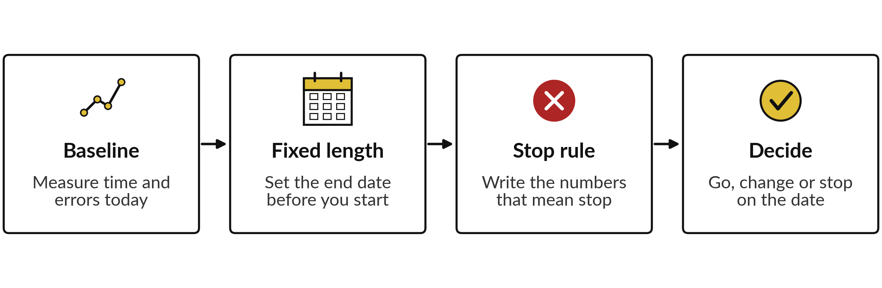
A pilot has a baseline, a
fixed length and a stop rule
Use your own data and your own success measure.
Notes:
A pilot is how you buy without betting the company. First a baseline, which you already know how to write from Session 1. Second a fixed length, with the end date set before you start. Third a stop rule: the numbers that mean you stop, written before the vendor shows you any results.
Fourth, a decision on the date: go, change or stop. Run the pilot on your own data with your own success measure. If a vendor refuses a pilot on your own data, weigh that heavily before you sign.

Slide 12
How to mark one line of a proposal
OrbitDesk is an invented vendor. The proposal is a teaching document for Nile Valley Foods.
The line
“The Agent delivers industry-leading accuracy on every document, and gets smarter every day.”
The mark
No number, no test and no definition of accuracy.
The question
What error rate have you measured on invoices like ours, and can we run our own test first?
Notes:
Before I read a whole proposal, here is one worked line so that you see the method. The proposal says the agent delivers industry-leading accuracy on every document, and gets smarter every day. Mark it: there is no number, no test and no definition of accuracy. Then write the question the mark needs answered: what error rate have you measured on invoices like ours, and can we run our own test first?
Every mark gets a question like this. In a moment I read the proposal live and we use the same pattern on other lines. I will not tell you how many there are.

Slide 13





Five clauses to check before anyone signs
Clause | Look for | Ask for
Data | Use of your data to train models; where it is stored | Training off by default, in writing
IP | Who owns your prompts, workflows and outputs | Ownership in your company’s name
Liability | The cap, and what a breach would cost you | A cap that matches the risk
Termination | Minimum term, notice, renewal and price rises | Short notice and a renewal cap
Exit | Export of your data and settings; deletion | Usable export and proof of deletion
Notes:
Five clauses to read before anyone signs, and you will meet each of them in the proposal. Data: does the vendor train on your data, and where is it stored?
IP: who owns your prompts, workflows and outputs?
Liability: what is the cap, and what would a breach cost you?
Termination: the minimum term, the notice period, automatic renewal and price rises at renewal. Exit: can you export your data and settings in a usable form, and will the vendor delete the rest and prove it?
You do not need to be a lawyer to ask these. A lawyer should still read the final contract.

Slide 14




Nobody signs alone: five people
should approve an AI purchase
The task owner confirms it solves the problem.
Finance checks the first-year total and the term.
IT or security checks data and access.
A lawyer reads the contract.
The accountable executive signs and owns the risk.
Notes:
Who approves?
Five roles. The task owner confirms that the tool solves the real problem, using the baseline. Finance checks the first-year total and the length of the term. IT, or whoever looks after security, checks data and access. A lawyer reads the contract. And the accountable executive signs and owns the risk.
In a small company one person may hold two roles, but write down who holds each one. When a vendor says the price is only available until Friday, this list is your answer. Now let me show you the whole method on a real-looking proposal.

Slide 15
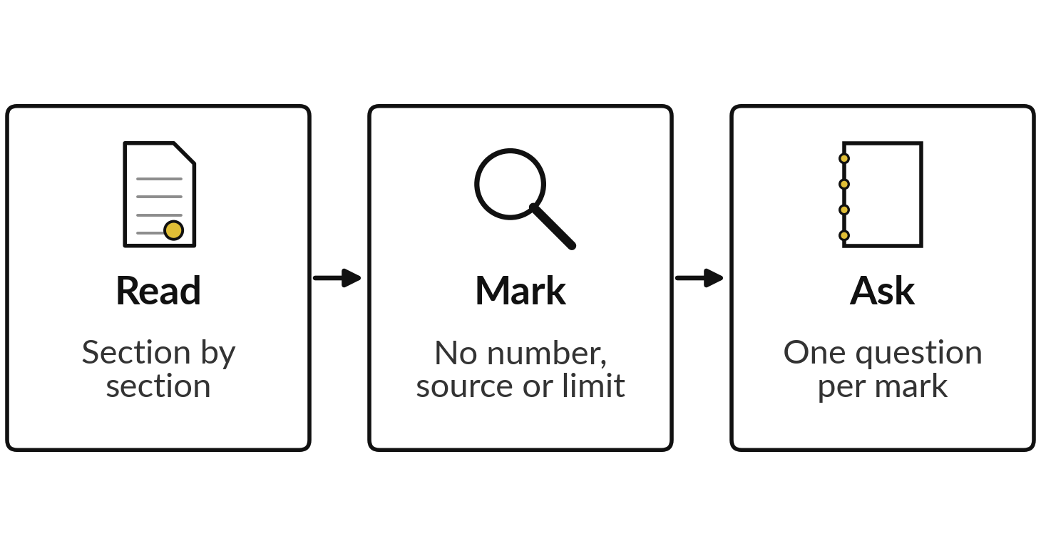
Demonstration: read the OrbitDesk
proposal and mark what you cannot check
I will show
Watch for
Words with no number or no source.
What the vendor asks you to share or sign.
What the proposal leaves out.
Notes:
Now I read the proposal aloud. OrbitDesk is an invented vendor, and the proposal is a teaching document written for Nile Valley Foods, so no real company is described. I read it section by section with the Finance Manager’s eyes. You have seen how to mark one line.
I mark each claim that has no number, no source or no limit, and I say the question that each mark needs answered. Watch what the vendor asks you to share or sign, and what the proposal leaves out. Follow the three steps on the left, mark your own printed copy as I go, then we compare.

Slide 16
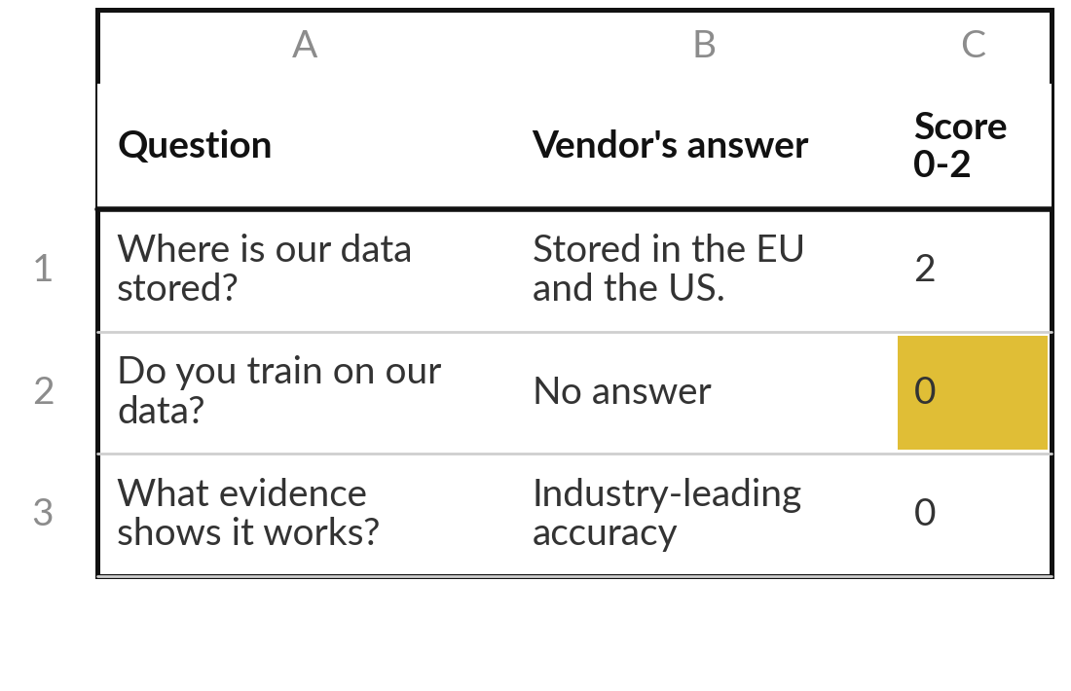
Practice: score the sample
proposal with the question list
25 minutes
The OrbitDesk sample proposal
Score OrbitDesk against the Vendor Question List.
Score groups 1, 2 and 5 first: data, security, contract and exit.
Write the proposal’s own words, or “no answer”. A silence scores 0.
Read the Summary: a 0 in those groups is a reason to stop.
Note the three biggest gaps.
You keep: A scored question list and your three biggest gaps.
Notes:
Take twenty-five minutes. Open the Vendor Question List. Thirty questions in twenty-five minutes is tight, so score groups one, two and five first: data and privacy, security, and contract and exit. Then move to the other groups if time allows. For each question, find the answer in the proposal and write it in the vendor’s own words.
If the proposal is silent, write no answer. Score zero for a red flag or silence, one for partly clear, two for clear and in writing. Then read the Summary sheet. A zero in data, security, or contract and exit is a reason to stop. Note your three biggest gaps.

Slide 17
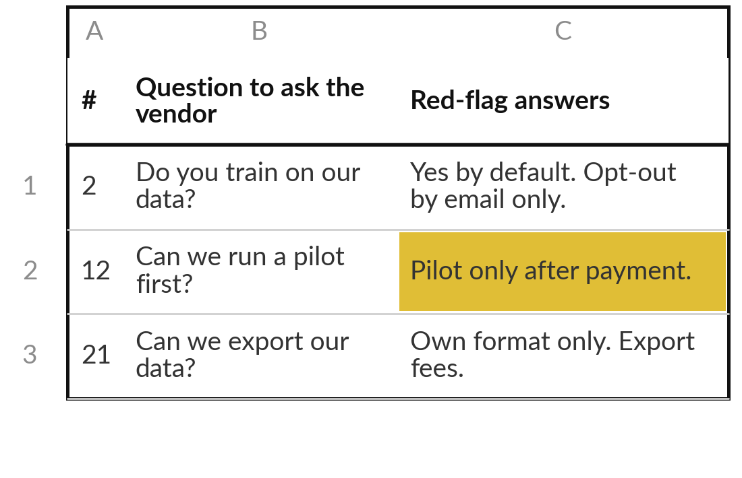
Practice: write the five
questions for your own vendor
20 minutes
Your own company task
Pick the five questions that matter most for your task.
Start with your question from last time: what must you know before saying yes?
Pick five from the list, or write your own, and add the red-flag answer.
Add the evidence you would accept, such as a report or a pilot result.
Put them in the order you will ask.
You keep: Five questions with red-flag answers, ready to send.
Notes:
Twenty minutes for your own five questions. Start with your question from last time: which product was pitched to you, and what must you know before saying yes?
Turn that into your first question. Then think about your own task and your own risk register. If your task involves personal data, a question about data use and storage belongs on the list. If it involves money, ask about approval steps and caps. For each question, write the answer that would worry you, and the evidence you would accept.
Put them in the order you will ask. If you have a real vendor in mind, the questions are ready to send in writing.

Slide 18



Decision: build, buy or partner for your own task?
Which route fits your own task today?
Build
Buy
Partner
The task is yours alone and an owner has time. You already hold a test log.
Many companies share the task and a product is proven on your kind of data. Pilot first.
You need set-up and support you lack. Keep data ownership and exit terms.
Write the route, the reason and the first step on your question list.
Notes:
Decide for your own task. Build if the task is yours alone and an owner has time, and you already hold a test log from Session 8. Buy if many companies share the task and a product is proven on your kind of data; run a pilot first.
Partner if you need set-up and support you lack, and keep data ownership and exit terms in your hands. There is no best route. For a buy or partner route, ask the vendor for a first-year total in writing. In Session 11 you put its one-off fees in the One-off column and its licence, divided by twelve, in the Tool licences line. Write the route, the reason and the first step.

Slide 19
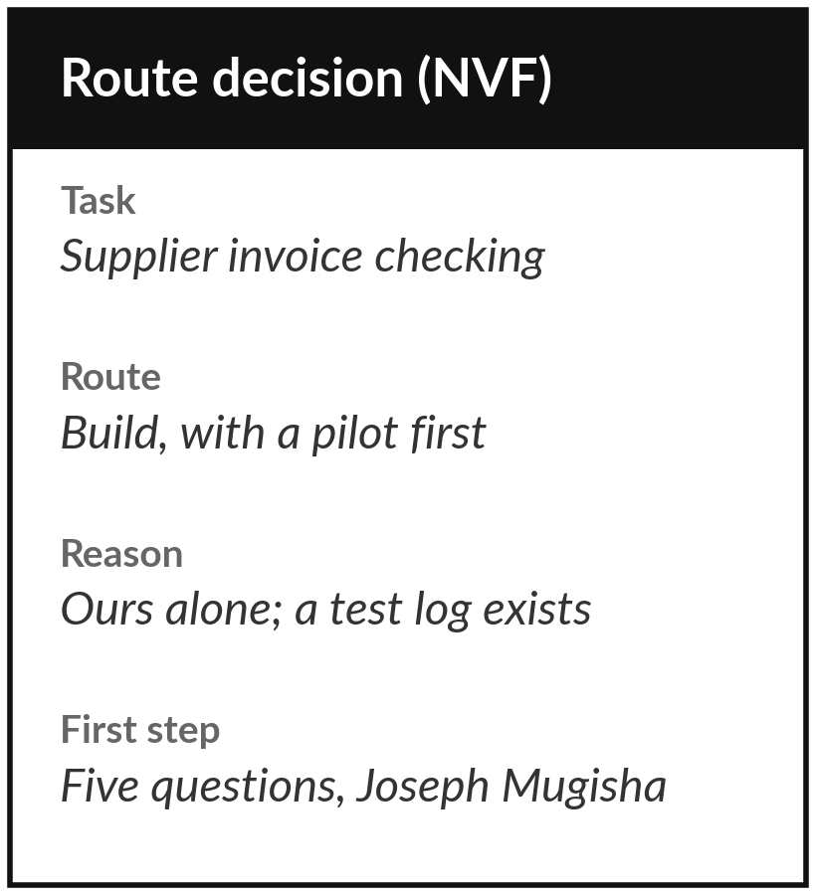
Save it, and bring one question to the next session
What you keep from today
Your vendor question list and a build, buy or partner decision for your own task.
Our question today
How do I question a vendor and decide build, buy or partner?
Next session
Session 11: The business case. You will cost your task and say what would change your mind.
Notes:
Save your scored question list and your five questions together. Next session we cost your task and write the business case, so your build, buy or partner decision is the starting point. Optional, if you want a head start: send your five questions to one real vendor and keep the replies in writing.
Then ask yourself one question to carry into Session 11: what would this route cost me in the first year, in hours and in shillings?
We began with this question: How do I question a vendor and decide build, buy or partner? Before you go, say in one sentence what you can now say about it.

